Slide 1
VersionLearn
A Collaborative Learning App
B. Hemanth Chowdary
192211206
Computer Science & Engineering

Slide 2
PROBLEM
Students lack an engaging, collaborative platform to ask doubts, share study resources, and track their academic progress in a unified space.
SOLUTION
VersionLearn is a collaborative learning app that provides subject-specific hubs, peer-to-peer doubt resolution, and progress tracking to enhance student engagement and academic growth.

Slide 3
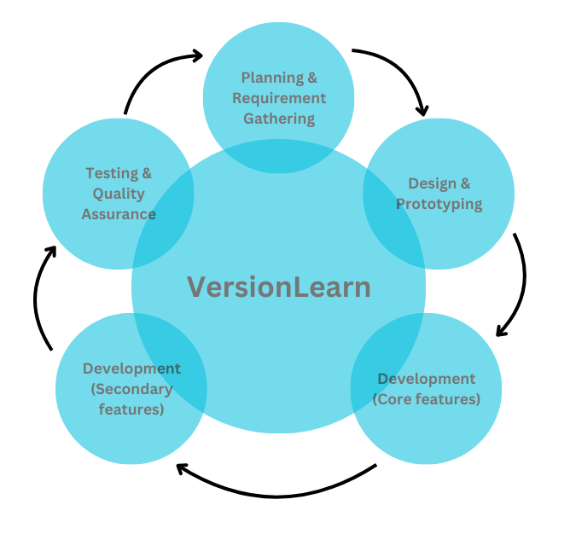
PRODUCT DESIGN
LIFE CYCLE

Slide 4
ARTICLE
Article Link: https://arxiv.org/abs/2107.07385
Conclusion
The research paper "Together We Learn Better: Leveraging Communities of Practice for MOOC Learners" highlights the importance of fostering peer interactions in Massive Open Online Courses (MOOCs) to enhance learning experiences. It introduces "PeerCollab," a platform designed to create close-knit learning communities where learners can actively engage with peers. By focusing on meaningful interactions, PeerCollab helps bridge the gap often present in online learning environments, encouraging collaboration and a sense of belonging. This approach not only enriches individual learning but also cultivates a supportive and interactive ecosystem, crucial for the success of MOOC participants.

Slide 5
PROBLEM STATEMENT
"Student" is a "learner" who needs "a collaborative learning platform to solve academic problems, share study resources, and track progress" because "current education apps lack engagement, peer support, and personalized learning experiences."

Slide 6
MY ROLE
Developer for VersionLearn
MY RESPONSIBILITIES
Define Product Vision: Plan the app’s features and roadmap.
Team Collaboration: Guide developers, designers, and content creators.
User Research: Collect feedback from students to improve the app.
Feature Prioritization: Focus on key features like subject hubs and gamification.
Progress Monitoring: Track project milestones and ensure timely delivery.
Stakeholder Communication: Present progress and updates to mentors and users.

Slide 7
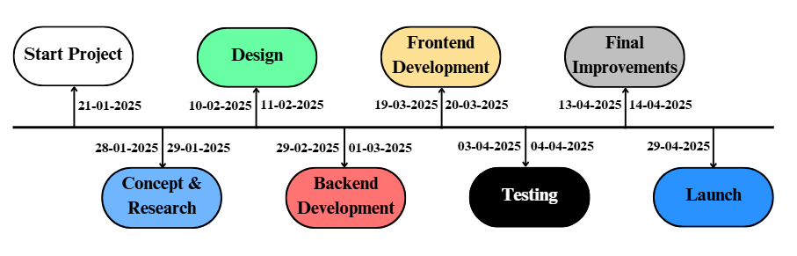

Slide 8
UNDERSTANDING THE USER
ASPECT | USER 01 | USER 02
NAME | Haneesha | Bharath
AGE | 15 years old | 17 years old
EDUCATION | 10th Grade Student(CBSE) | 12th Grade Student
NEEDS | Solve difficult math problems; Access study notes for exams | Clarify doubts in physics/chemistry; Track subject progress for competitive exams
PAIN POINTS | Struggles with challenging questions; Lacks motivation | Limited access to mentors; Difficulty tracking progress
HOW VersionLearn HELPS | Math Hub for problem-solving; Gamification for engagement | Mentor support for tough topics; Progress tracking tools

Slide 9
USER JOURNEY MAP
STAGE | DESCRIPTION | GOAL
AWARENESS | The user hears about VersionLearn through social media or a school recommendation. | Discover a tool to enhance their academic learning.
ONBOARDING | The user downloads the app, creates an account, and selects subjects of interest. | Successfully set up their profile and explore basic features.
ENGAGEMENT | The user posts a math question in the Math Hub for help. | Get a clear and quick solution from peers or mentors.
ACHIEVEMENT | The user shares notes for a topic and participates in a weekly challenge. | Actively collaborate and receive recognition for contributions.

Slide 10
COMPETITION ANALYSIS
FEATURE | VersionLearn | Toppr | Byju’s | Doubtnut
Collaboration | Yes, peer learning and mentors | Limited | No | No
Subject-Specific Hubs | Yes, dedicated hubs for each subject | No | No | No
Progress Tracking | Yes, personalized subject progress | No | Limited | No
Language Practice Tools | Yes, vocabulary games and quizzes | No | No | Yes
Target Audience | Students up to 12th grade | K - 12th | K - 12th | K - 12th

Slide 11
BUSINESS POTENTIAL
EdTech growth: Global market projected to reach $400B by 2027.
Opportunity: Rising demand for interactive and collaborative learning tools.
GAP ANALYSIS
Existing Gaps: Lack of platforms combining collaboration, gamification, and personalized progress tracking.
How VersionLearn Fills It: Provides subject hubs, peer mentoring, and gamified learning.
TARGET AUDIENCE & MARKET SIZE
Students from Grade 6 to 12 seeking academic support.
Over 250 million school students, 80 million in upper primary and secondary.

Slide 12
USER PAIN POINTS
Pain Point 1:
Difficulty in accessing reliable and organized study resources.
Pain Point 2:
Lack of collaborative platforms for solving academic problems together.
Pain Point 3:
Limited tools for tracking subject-specific progress effectively.

Slide 13
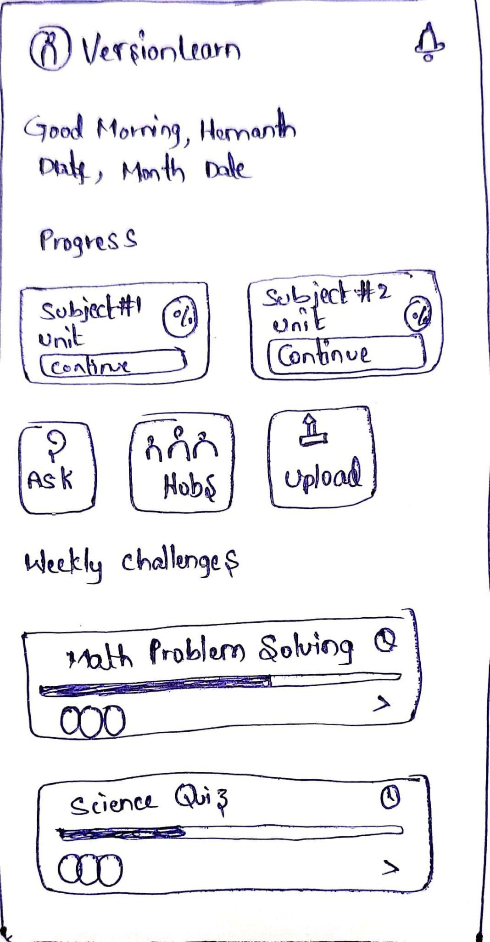
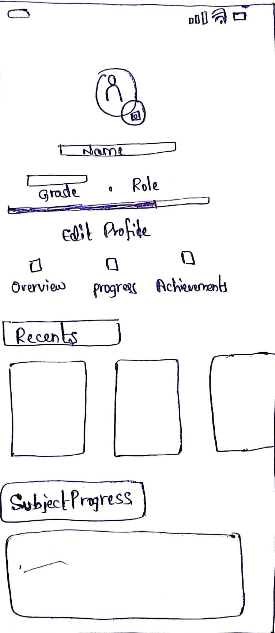
Rough Sketch

Slide 14
Ideation Alternatives
Alternative 1: PeerCollab with Group-Based Discussions A platform that forms small groups of learners with shared interests for targeted discussions and collaboration. Pros: Promotes focused peer-to-peer learning. Cons: May exclude users with diverse preferences.
Alternative 2: Open Community Forum A global discussion board where all users can participate and share ideas. Pros: Allows maximum inclusivity and networking. Cons: Overcrowded and difficult to moderate.
Alternative 3: Gamified Collaboration Introduce gamification elements like leaderboards and rewards to motivate peer interactions. Pros: Encourages engagement and participation. Cons: May distract from learning objectives.

Slide 15
Iterations
First Iteration: Focused on basic chat and discussion functionality within predefined groups. Feedback: Users wanted more personalized group formations based on interests.
Second Iteration: Introduced interest-based grouping and a recommendation engine for groups. Feedback: Lacked tools for meaningful collaboration, such as shared whiteboards or file-sharing options.
Third Iteration: Added collaborative tools, such as shared task boards, whiteboards, and real-time editing. Feedback: Overall satisfaction improved, but navigation felt cluttered.

Slide 16
Learnings
Peer interactions thrive with tools that support structured and meaningful collaboration.
Personalization is critical to maintaining engagement in communities of practice.
A balance between simplicity and functionality is key—users avoid platforms that feel overwhelming.
Gamified elements, while engaging, should complement learning, not detract from it.

Slide 17
Usability Studies
Navigation and Interface
Positive: Dashboard is intuitive and well-organized.
Issue: Users struggled to find "Notification Settings."
Recommendation: Add a dedicated “Settings” tab
Notifications and Alerts
Positive: Real-time notifications appreciated.
Issue: Repeated reminders felt overwhelming.
Recommendation: Allow users to customize notification frequency.
Event Details and Filters
Positive: Clear event details and effective category filters.
Issue: No date-based search option.
Recommendation: Add a calendar view for browsing events.
Personalization
Positive: Personalized event suggestions are engaging.
Issue: Onboarding doesn’t ask about user interests.
Recommendation: Include an interactive onboarding process.

Slide 18
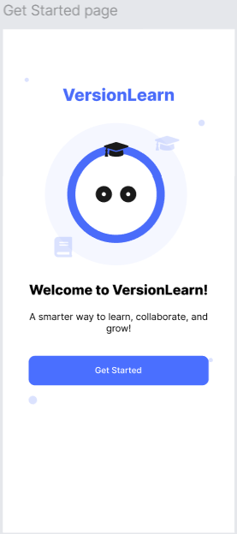
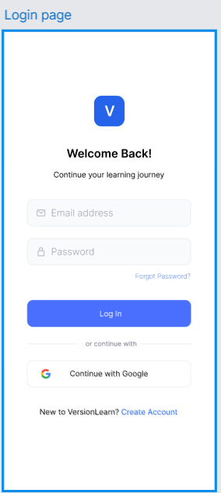
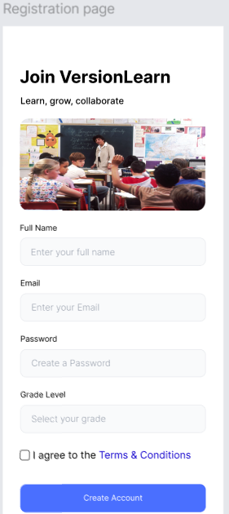
Sample Product - Login Page

Slide 19
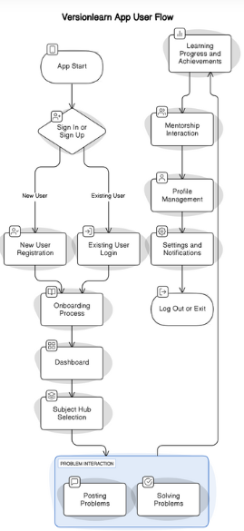
Product Design - User Flow

Slide 20
Project Design Mockups
Login/Sign-Up Page
Dashboard/Home Page
Subject Hubs (e.g., Math Hub, Language Hub)
Post/Answer Workflow (Question and Answer UI)

Slide 21
Impact of VersionLearn
How it benefits students:
Encourages collaborative learning and peer support.
Simplifies subject-wise organization for doubts and resources.
Motivates students with gamification elements.
Wider reach:
Promotes learning across schools and regions.
Brings mentorship accessibility for students who lack it offline.
Academic growth:
Tracks progress to help students and parents focus on weak areas.
Include a quote: “Empowering students through collaboration and innovation!”

Slide 22
Key Learnings from VersionLearn Development
Technical Skills:
Creating user workflows and mockups.
Understanding UI/UX design principles.
Exploring subject-specific tools for gamification and progress tracking.
Team Collaboration:
Coordinating with mentors, friends, or colleagues for feedback.
Balancing features and simplicity for end users.
Problem-Solving:
Identifying the common academic issues faced by students.
Designing features to address specific needs (e.g., notes sharing, doubts solving).
Time Management:
Managing deadlines while focusing on quality design and functionality.

Slide 23
Product Design Patent for VersionLearn
What is a Product Design Patent?
Protects the visual design and functional uniqueness of the app.
Secures intellectual property to avoid duplication.
Why Patent VersionLearn?
Ensures originality in collaborative learning design.
Protects unique features like Subject-Specific Hubs and Community-Driven Solutions.
Patent Focus Areas:
User interface design (intuitive subject hubs, dashboards).
Gamification workflows (badges and challenges).
Unique note-sharing structure with categorization.

Slide 24
Next Steps for VersionLearn
Step A: Finalizing Design & Development
Conduct final reviews of UI/UX for seamless navigation and accessibility.
Implement key features:
Subject-Specific Hubs.
Gamification.
Shared Notes Interface.
Step B: Usability Testing
Perform user testing with a sample group of students, parents, and mentors.
Collect feedback and refine features like progress tracking and collaboration tools.
Step C: Launch Strategy
Create a marketing plan targeting schools, parents, and tutoring institutions.
Plan for a beta release in select regions before the official launch.
Prepare tutorial videos and user guides for the app.

Slide 25

Let’s Connect
Email ID: hemanthbezawada7@gmail.com
Phone: +91 8309389928
Social Media Handles
Instagram: https://www.instagram.com/_mr._.hemanth/
Twitter: https://x.com/_mr_hemanth_55?t=Ipz4wxOLU_xHI1-lIFtqbQ&s=09

